Slide 1
AWS Budgeting Presentation
How do Amazon Web credits work, and how much will we need?

Slide 2
AWS free tier (12 months):
Lots of time (750hrs per month)... on a really weak server
25GB storage

Slide 3
AWS Four Ways to Pay
On Demand Pricing:
Pay for computing capacity by the hour or second (unpredictable workload)
Reserved Instances:
Pay one instance (good for steady projects with steady work load)
Spot Instances:
Adding spare computing capacity when needed (more computing capacity is needed instantly)
Dedicated Hosts
Physical server dedicated to you

Slide 4
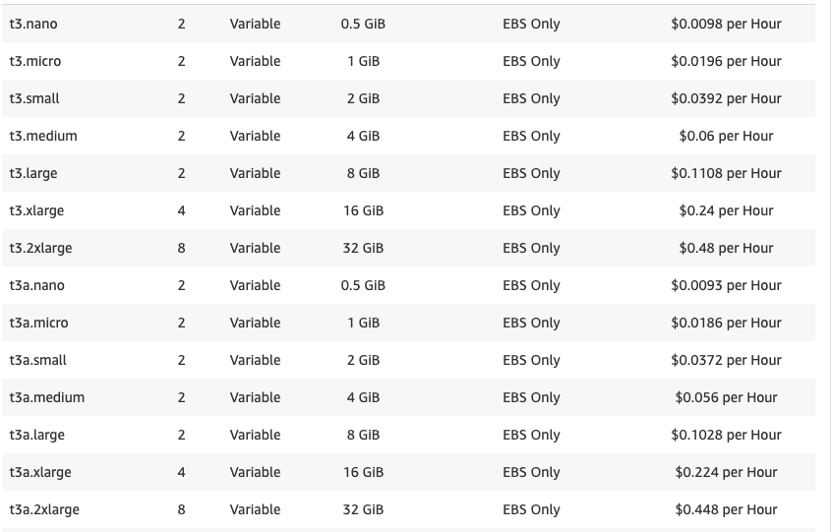
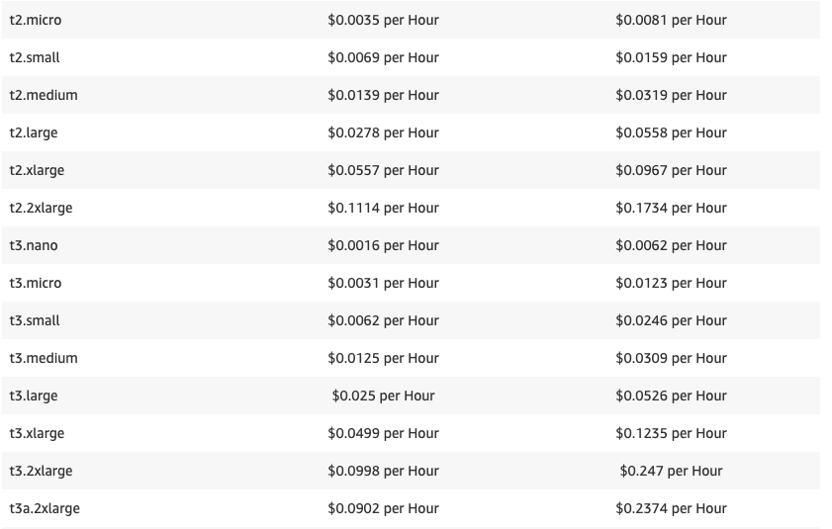
On Demand Pricing
Spot Pricing

